Slide 1

Cloud Computing Introduction
A few foundation services
LinkedIn: https://linkedin.com/in/cgswong
@cgswong

Slide 2
Agenda
Identity & Access Management (IAM)
Virtual Private Cloud (VPC) Networking
Compute – EC2 & Lambda
Cloud-scale NoSQL database - DynamoDB
Q&A

Slide 3
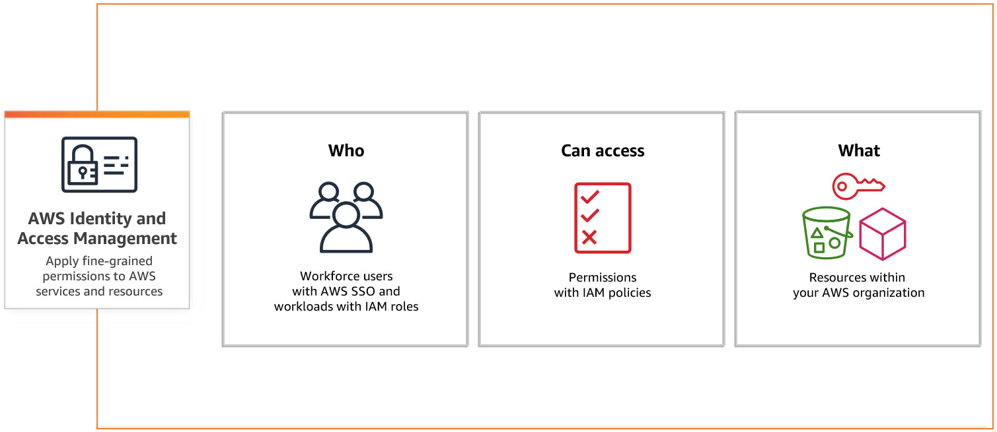
IAM
Notes:
IAM
Facilitates secure management to AWS services
Administers permissions that dictate users access to specific AWS resources
Oversees both authentication (user sign-in) and authorization (permissions granted) to resource usage
Access Keys
Users can have access keys (Access Key ID and Secret Access Key) for programmatic access to AWS services and APIs.
These keys are used in scripts and applications to make AWS requests.
Best Practices
Implement the principle of least privilege to grant only necessary permissions.
Regularly review and update policies and permissions.
Enable MFA for privileged users.
Use roles for applications and services when possible.

Slide 4
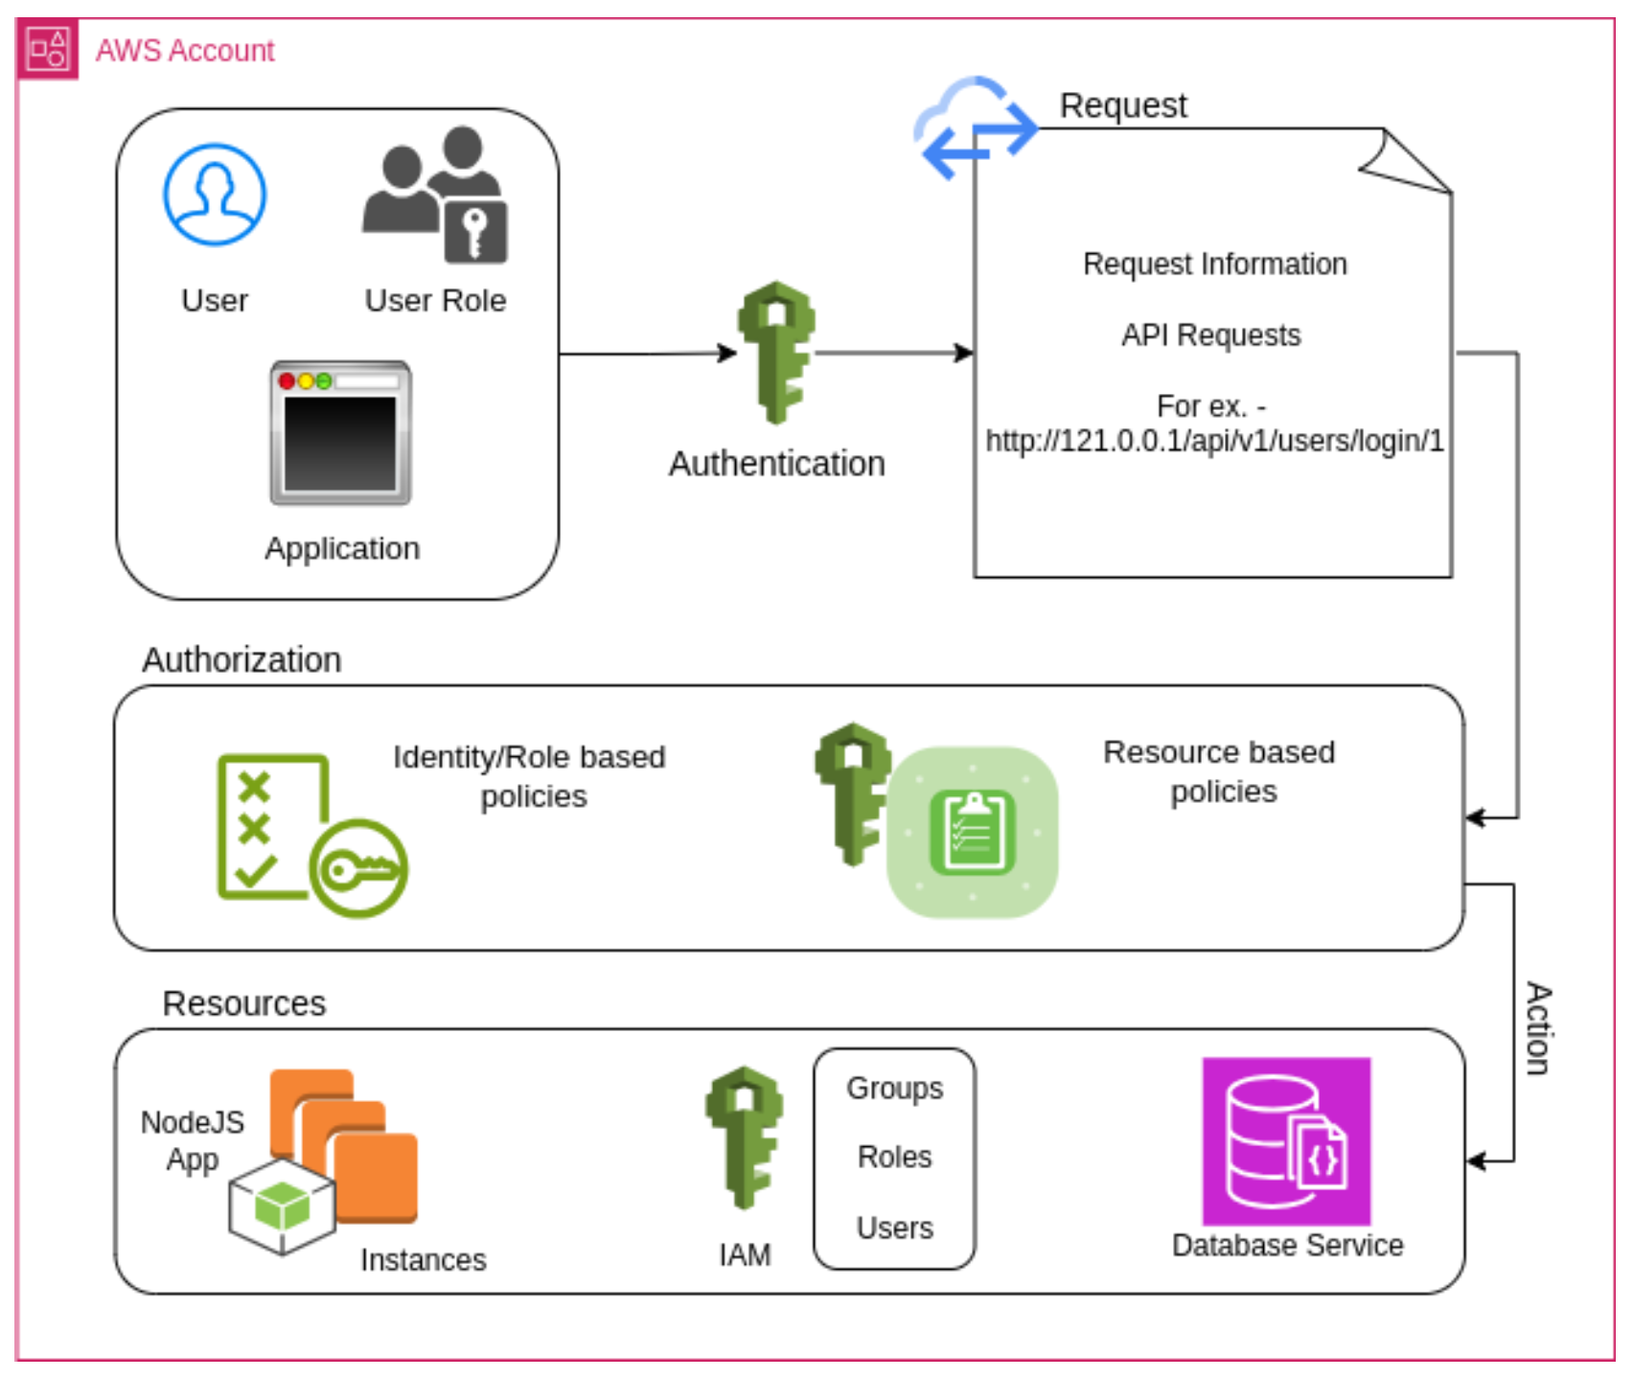
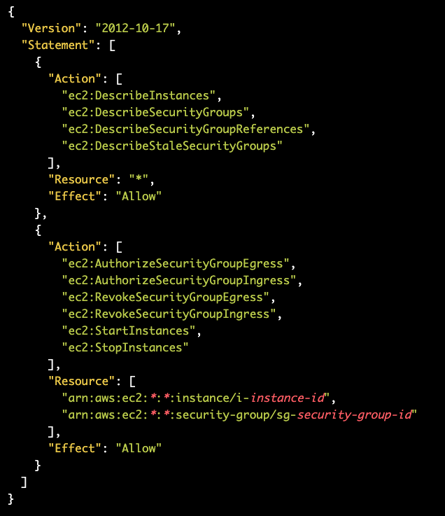
IAM Policy

Slide 5
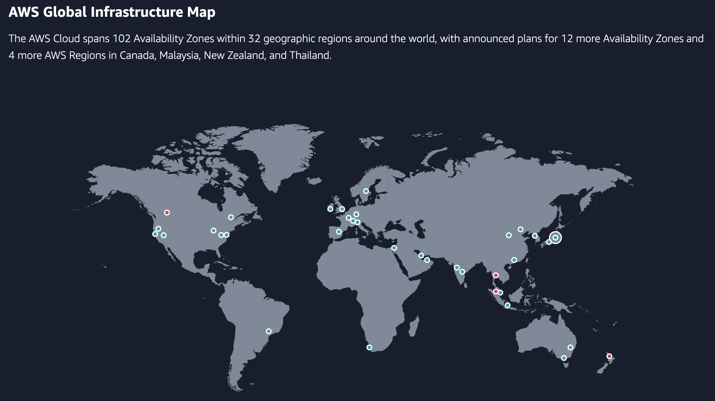

Slide 6
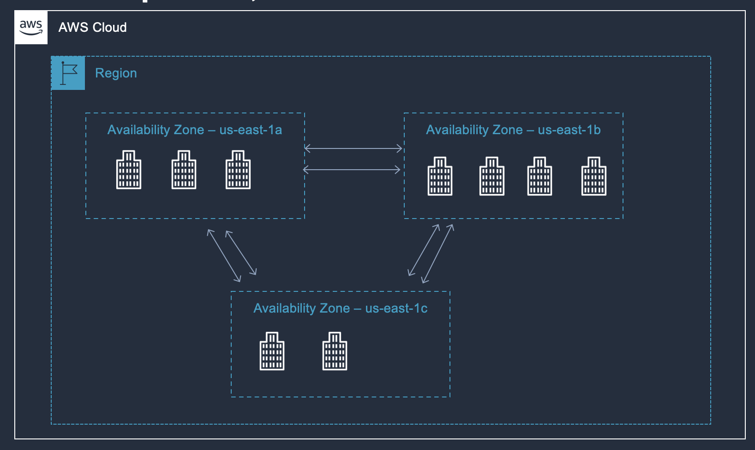
VPCs Explained
1 Region = Multiple Azs (3+)
1 AZ = Cluster of DC
Each AZ is independently powered, cooled, and maintained, but interconnected via redundant, ultra low-latency, high-speed links
Notes:
DCs within an AZ are interconnected, and AZs are connected by high-speed links.
While regions are dispersed across geographic regions to avoid catastrophic events, AZs within a region are localized within several miles (let's say 60 miles) which may not align with certain federal or industry criteria for DR or BC.
Note that AZs are different across accounts. This is intentional to provide some isolation and avoid wide-spread customer outages. In cases where using the same AZ across accounts is important, the AZ-ID should be used to provide alignment.
CIDR is Classless Inter-Domain Routing, and is simply a short form of how network is divided.
Maximum CIDR is /16, minimum is /28
CIDR calculator: https://www.subnet-calculator.com/cidr.php
10.0.0.0: Network address.
10.0.0.1: AWS reserved for the VPC router.
10.0.0.2: AWS reserved for the VPC DNS router service (always located in the primary CIDR). AWS also reserves the base of each subnet range plus two for all CIDR blocks in the VPC. Reference Amazon DNS server.
10.0.0.3: AWS reserved for future use.
10.0.0.255: AWS reserved for the network broadcast address (note that AWS does not support broadcast in a VPC).

Slide 7
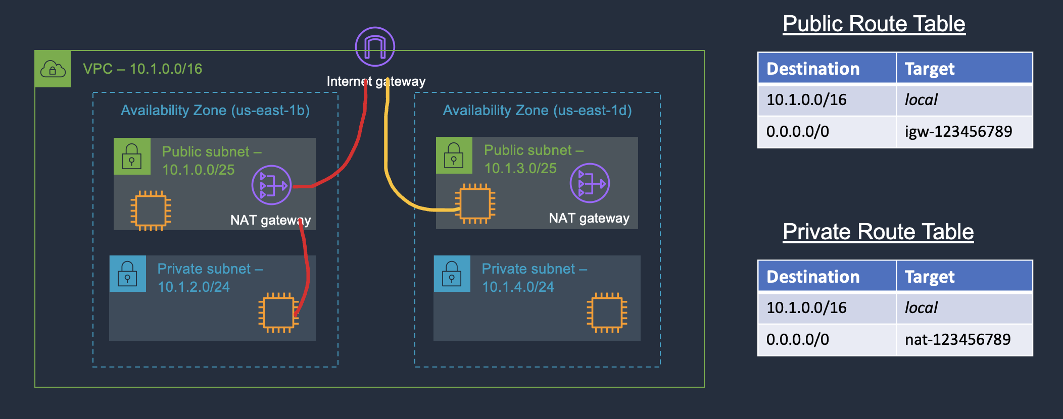
Routing – How resources communicate
Notes:
Routing is crucial!!
Public subnet is any that has route to IGW.
NAT Gateway must be in public subnet
NAT Gateways have Elastic IPs (can be used in accept list since they are static).
NAT Gateway does have throughput and connection limits which should be considered. One per AZ is recommended for HA, but also throughput.
Can use one or more route table, but a subnet must be associated to a single route table
Shortest (most specific) route takes precedence
Security groups protects any resources which has an ENI. It is for resource protection.
Network ACLs protects the subnet, for network protection.

Slide 8
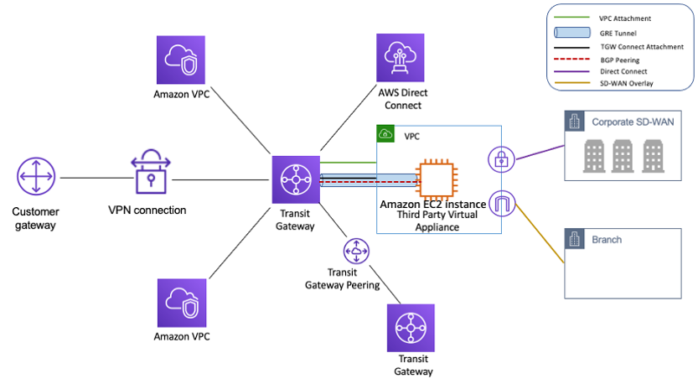
Inter-network Routing (talking across networks)
Notes:
Preferred solution for larger or more complex networks (scale)
Manages multiple networks, inter-VPC (east-west), VPC-on-premise (DX, VPN) (north-south), inter-region
Routes cannot overlap

Slide 9
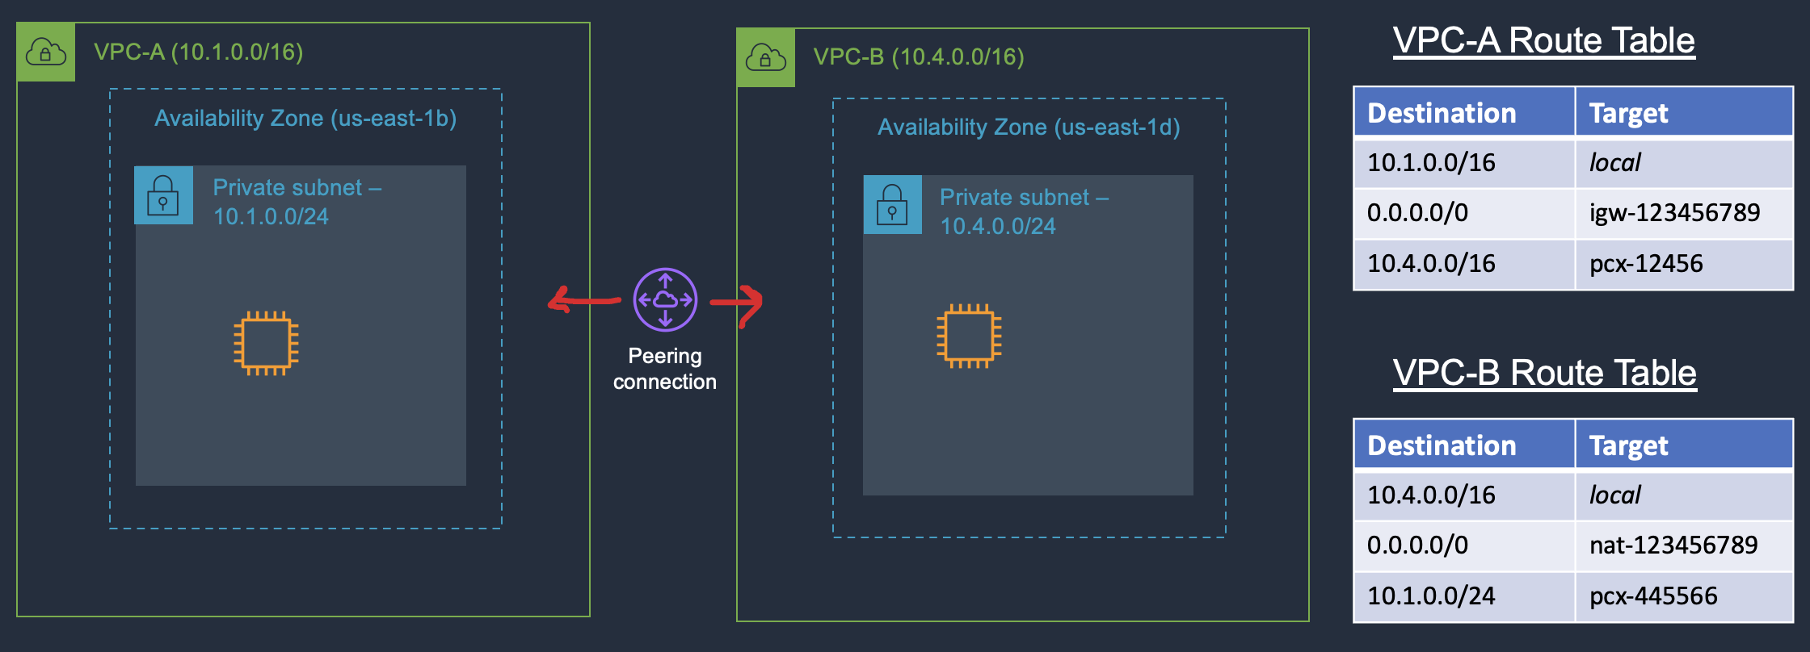
Inter-VPC Routing (Peering connections)
Notes:
Routes cannot overlap
Best for smaller networks (avoid complex mesh network), high-volume traffic (100’s of TB), and cost avoidance

Slide 10
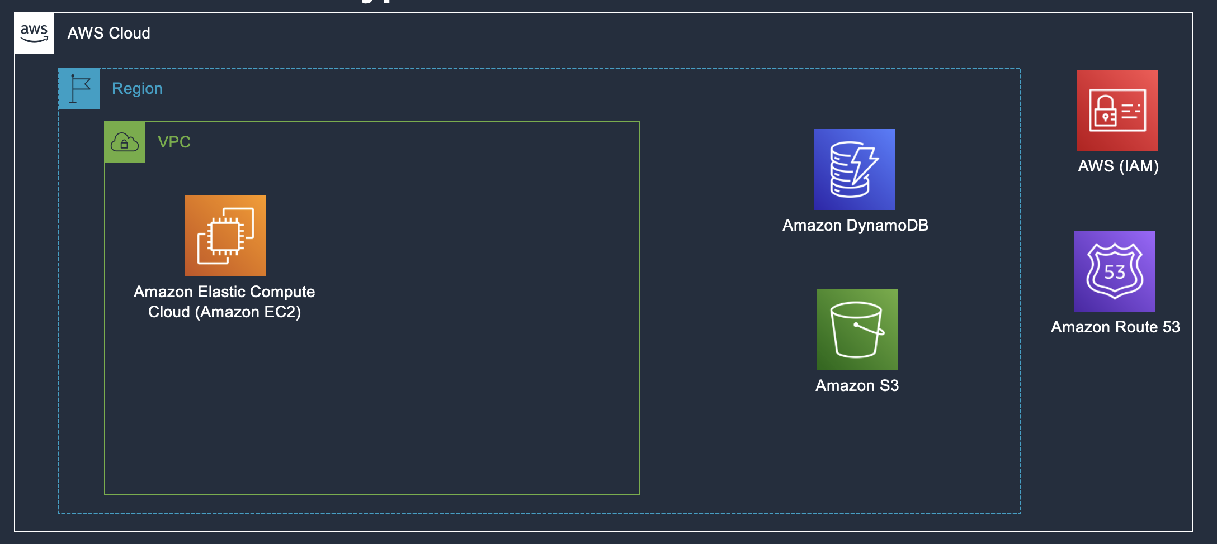
How resources depend on networking
Notes:
VPC (associated with AZs), region and global services

Slide 11
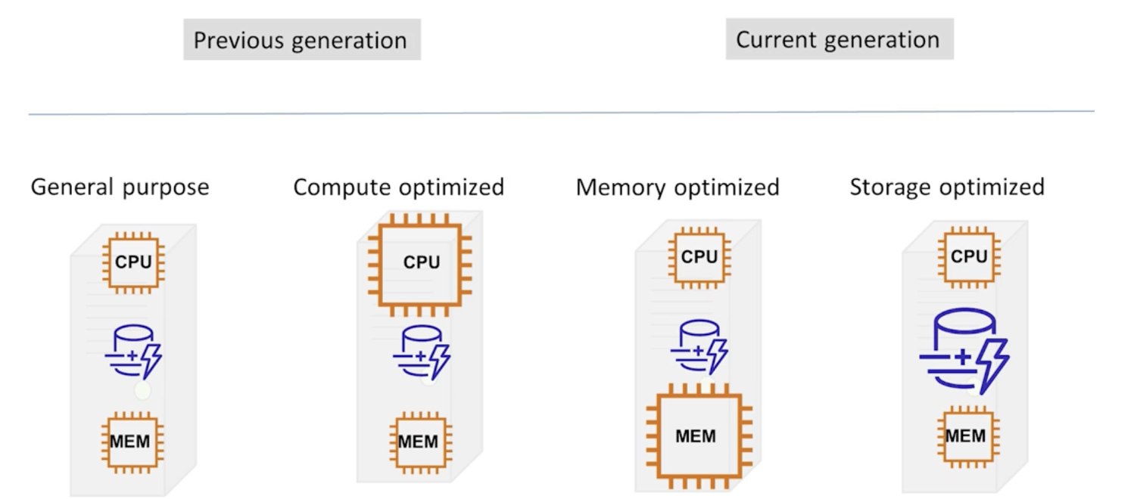
Computing with EC2 – Families and types
Notes:
Multiple types of instances for different use cases. Shown are the general categories, but there other, more special purpose types not shown, such as GPU types which fall within the compute optimized category.
To select, some knowledge of the type of workload is needed. Without any information, GP is good starting point.

Slide 12
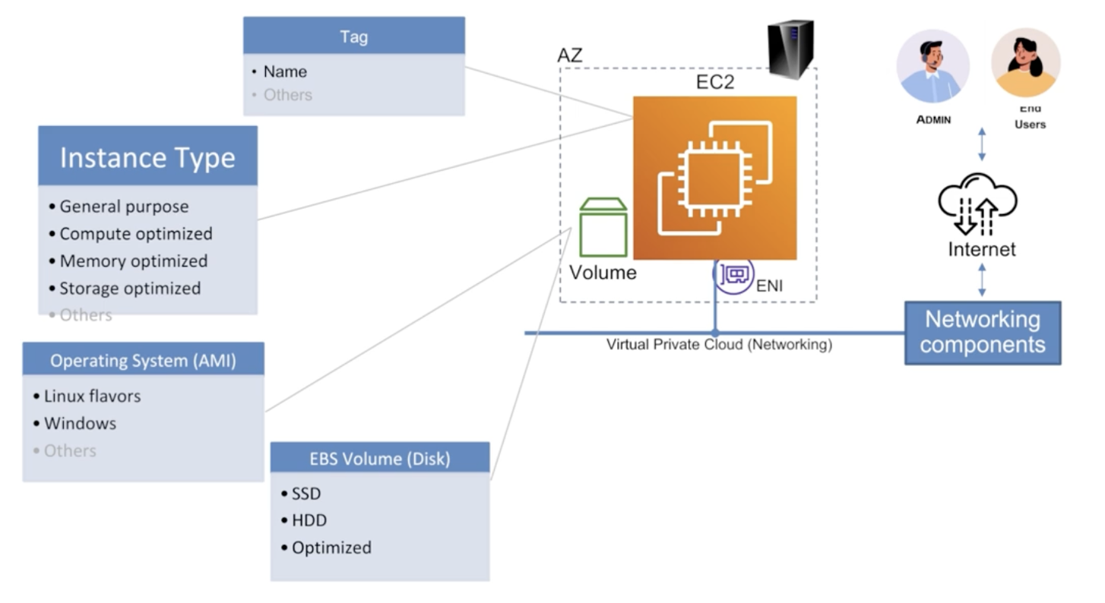
Computing with EC2
Notes:
EBS is storage primarily used, but there are others (such as instance store, EFS, FSx). Can also use S3!
Backups are created of the EC2 or more specifically the attached EBS volumes
Networking is a virtual private cloud (VPC)
Subnet is AZ location (physical server lives here)
Can have multiple (elastic) networking interfaces or ENI, for different use cases (isolated networks)
Each ENI will be associated with a security group or “firewall”. SG controls inbound / ingress / incoming traffic, and outbound / egress / outgoing traffic
Instances will be in a specific state: STOPPED, PENDING, RUNNING, STOPPING, SHUTTING-DOWN, TERMINATED
You can trigger using the states!
Monitor your instance, can use CloudWatch
Multiple options for cost savings, simplest is stop or terminate when not needed

Slide 13
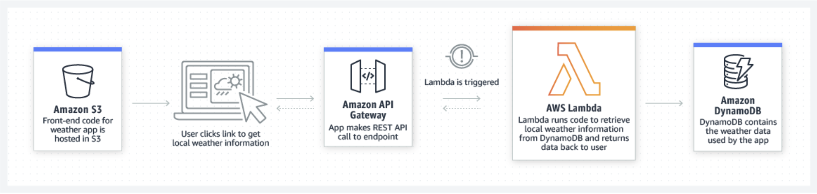
Computing with AWS Lambda functions
Notes:
Serverless, no compute to manage, or worry about
Focus on code with support for many languages, including custom runtimes
Provide code as a deployment package or container image, which gets executed in response to events (even-based) or triggered (includes scheduled)
Supported by many AWS services including S3, EventBridge, RDS, SQS, SNS, Step Functions, Kinesis, DynamoDB, etc.
Lambda services automatically scales (runs more functions) to handle requests.
Executes in isolated runtime environment
Functions are stateless, i.e. no state, so must store data / state in data services (DynamoDB, S3, etc.)
Supports environments variables, versions, and aliases (direct traffic to specific version)
Two types: Asynchronous (fire and forget), and Synchronous (waits and returns some response or value).
Pricing model based on executions and execution time.

Slide 14
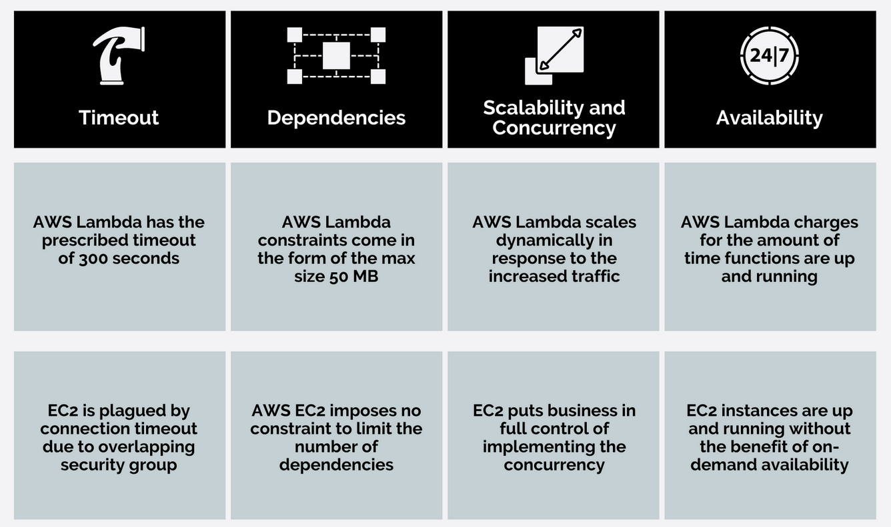
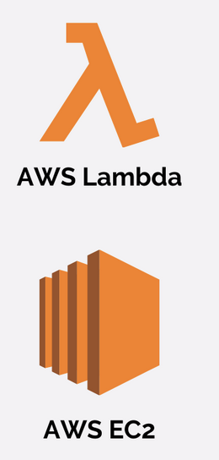
Computing – Lambda & EC2

Slide 15
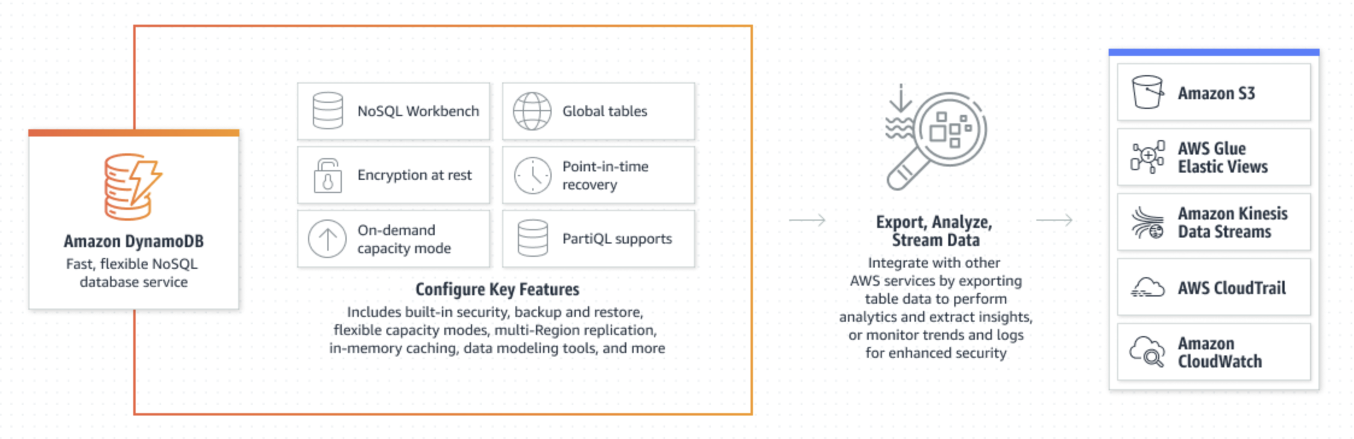
Cloud-scale database – Amazon DynamoDB
Notes:
Managed NoSQL database, meaning handles use case for unstructured or semi-structured data. That is, no schema ahead of time (schema-less). Stores data in the form of key-values. So, can store documents (the value with key some id), time-series (time is key, value is data).
Each DDB is a table
Primary key can be single key, or composite.
Encryption is our responsibility
Service handles scaling, patching, backups. Allows focus on application building.
Performance is predictable (key lookups), with single digit latency and below with caching capability (DynamoDB Accelerator or DAX)
Note that there are two capacity models: on-demand (auto-scale to meet read and write demand) and provisioned (pre-select expected reads and writes).
Two types of queries: scan (full table scan which is expensive in terms of time and cost), query (filter using some id so quicker and less cost)
Streams feature provides for change data capture, enabling interesting event-base workflows
There is an available local DynamoDB which mimics features on your local machine! Excellent development tool, saves money too.

Slide 16

Q&A

